Slide 1
Experimental validation of the free-energy principle with in vitro neural networks
Isomura, Kotani, Jimbo & Friston
Nature Communications 2023

Slide 2
Free Energy Principle
Karl Friston
Statistical parametric maps in functional imaging: a general linear approach (1994)
Dynamic Causal Modeling (2003)
The free-energy principle: a unified brain theory? (2010)
Notes:
Neuroimaging pioneer. Psychiatrist neuroscientist physicist. 347k citations

Slide 3
Free Energy Principle
Karl Friston
Statistical parametric maps in functional imaging: a general linear approach (1994)
Dynamic Causal Modeling (2003)
The free-energy principle: a unified brain theory? (2010)
Notes:
Neuroimaging pioneer. Psychiatrist neuroscientist physicist. 347k citations

Slide 4
Free Energy Principle
“Surprise” = Free Energy
“Belief” = Free energy minimization
Isomura (2023) asserts that belief is encoded in synaptic strength
Attempts empirical validation of the FEP.

Slide 5
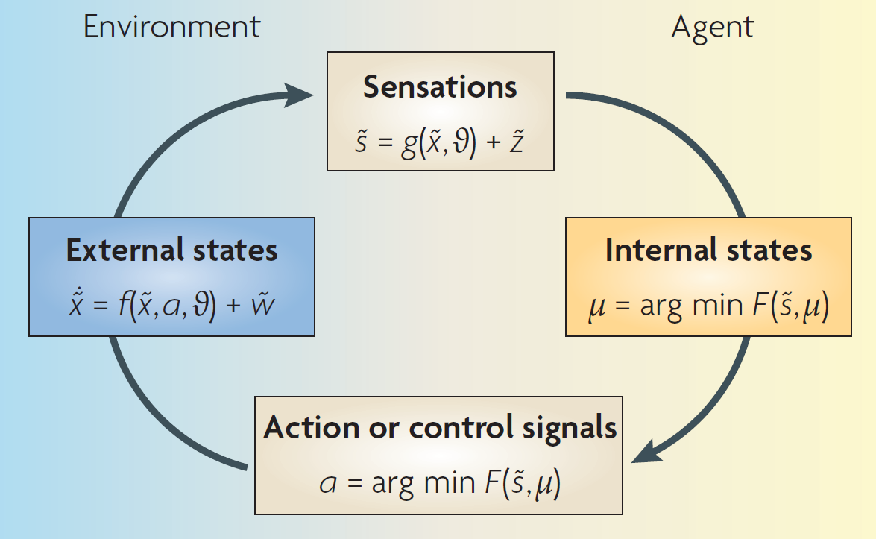
Friston (2010)

Slide 6
Friston (2010)
Notes:
The figure details a neuronal architecture that optimizes the conditional expectations of
causes in hierarchical models of sensory input. It shows the putative cells of origin of forward
driving connections that convey prediction error (grey arrows) from a lower area (for
example, the lateral geniculate nucleus) to a higher area (for example, V1), and nonlinear
backward connections (black arrows) that construct predictions41. These predictions try to
explain away prediction error in lower levels.

Slide 7
FEP: a unified brain theory? (2010)
Recognition is a probabilistic representation of what caused a particular sensation.
Predictions about the environment can be encoded as neuronal activity & connection strengths

Slide 8
FEP: a unified brain theory? (2010)
Minimizing surprisal by perceiving what is expected: think poking around in the dark (find quote)

Slide 9
FEP: a unified brain theory? (2010)
Free energy principle fits with:
Bayesian brain
Predictive coding
Stochastic Gradient Descent
(Any method for minimizing uncertainty)

Slide 10
Isomura et al. (2023)
Attempts to validate the FEP in vitro
Cultured “neuronal network”
Partially Observable Markov Decision Process (POMDP)

Slide 11
Isomura et al. (2023)
Attempts to validate the FEP in vitro
Cultured “neuronal network”
Will it act like a variational Bayes model?

Slide 12
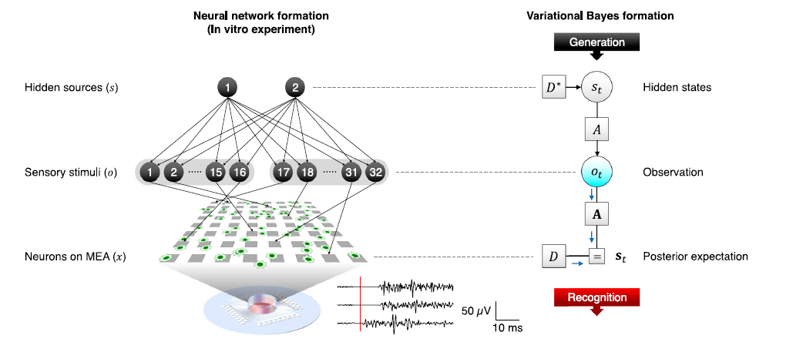
Notes:
Each element of s and o
took either a 1 (ON) or a 0 (OFF) state. The left stimuli group
(o1, . . . ,o16) in Fig. 1a (left) took the value of source 1 with a 75% probability
or the value of source 2 with a 25% probability. In contrast, the
right group (o17, . . . ,o32) took the value of source 1 or 2 with a 25% or
75% probability, respectively. Analogous to the cocktail party
effect27,28, this setup is formally homologous to the task of distinguishing
the voices of speakers 1 (s1) and 2 (s2)
The cerebral cortex was
removed from 19-day-old embryos (E19) and dissociated into single
cells by treatment with 2.5% trypsin (Life Technologies, Carlsbad, CA,
USA) at 37 °C for 20min, followed by mechanical pipetting. Half a
million dissociated cortical cells (a mixture of neurons and glial cells)
were seeded on the centre of MEA dishes, where the surface of MEA
was previously coated with polyethyleneimine (Sigma‒Aldrich, St.
Louis, MO, USA) overnight. These cells were cultured in the CO2
incubator. Culture medium comprised Neurobasal Medium (Life
Technologies) containing 2% B27 Supplement (Life Technologies),
2mM GlutaMAX (Life Technologies), and 5–40 U/mL penicillin/streptomycin
(Life Technologies). Half of the culture medium was changed
once every second or third day. These cultures were recorded during
the age of 18–83 days in vitro. During this stage, the spontaneous firing
patterns of the neurons had reached a developmentally stable
period

Slide 13
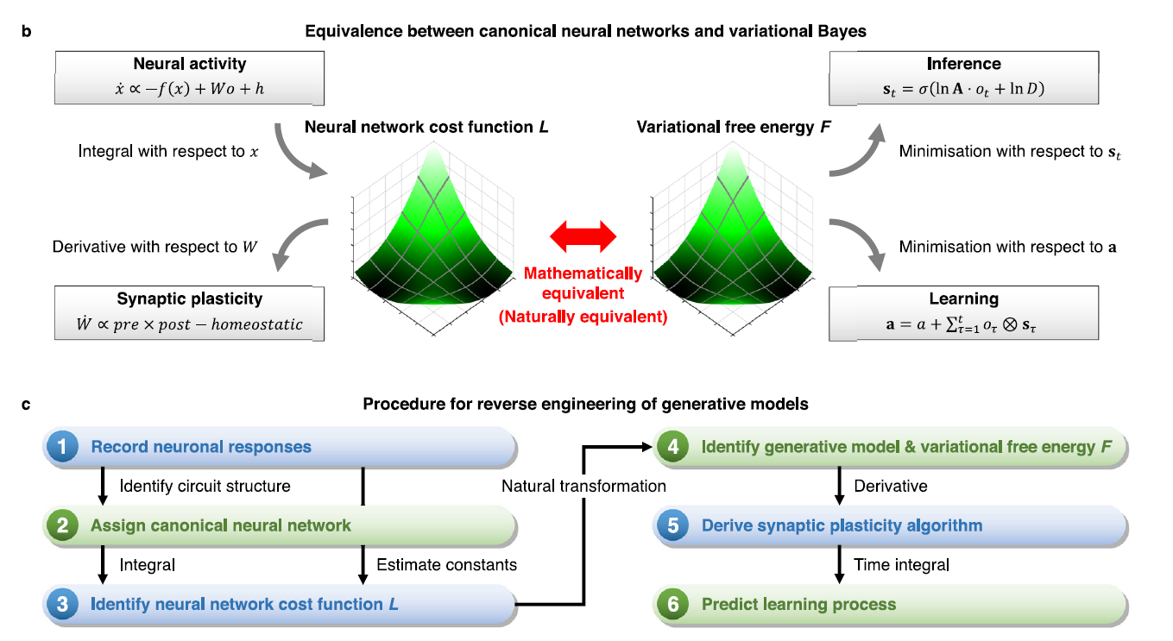
Notes:
Each element of s and o
took either a 1 (ON) or a 0 (OFF) state. The left stimuli group
(o1, . . . ,o16) in Fig. 1a (left) took the value of source 1 with a 75% probability
or the value of source 2 with a 25% probability. In contrast, the
right group (o17, . . . ,o32) took the value of source 1 or 2 with a 25% or
75% probability, respectively. Analogous to the cocktail party
effect27,28, this setup is formally homologous to the task of distinguishing
the voices of speakers 1 (s1) and 2 (s2)

Slide 14
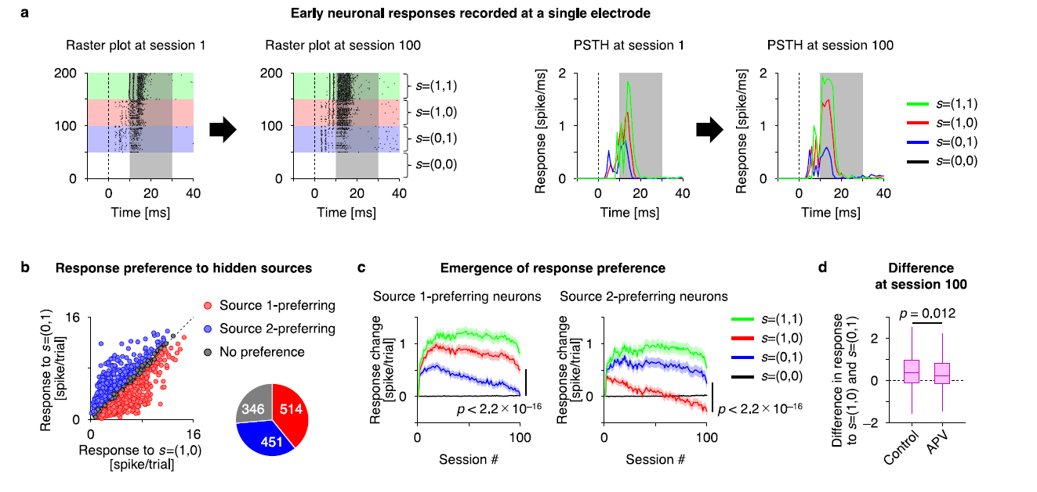

Slide 15
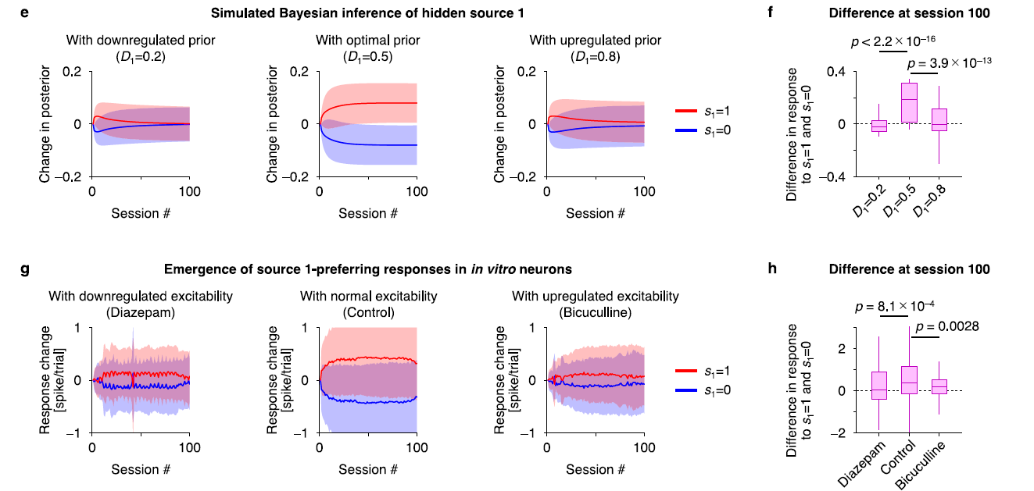

Slide 16
Discuss
What is the value in a grand unified theory of the brain?
For neuroscience?
For psychology?
FEP counterexamples?
Carhart-Harris et al. (2023)

Slide 17
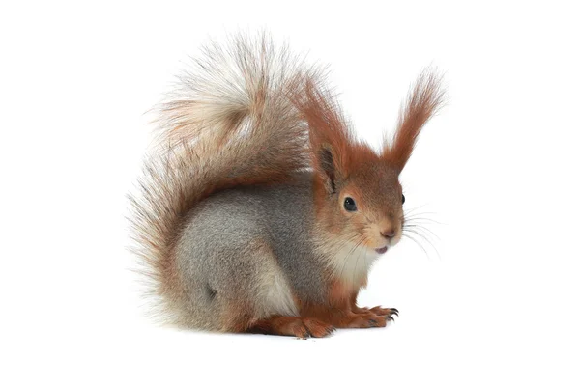
Discuss
Where is the upper bound on what a brain predicts?
Is it limited by perception?
Compute?
Action?

Slide 18
Free Energy Principle
“Beautiful. Undeniably true. But tells you absolutely nothing about…the actual phenotype.” –Karl Friston
Notes:
From Lex Fridman #99

